Slide 1

Business Plan Templates
Set up for success with strategic planning frameworks, including Lean Canvas, SWOT Analysis, Pirate Funnel, and more.

Slide 2
Create a Business Plan with a Lean Canvas
Lean canvas is a one-page business plan template created by Ash Maurya. It’s designed to create a snapshot of your business idea, distill the essence of your product or service, and break it down into key parts. Check out a completed example on the next page and then try filling out the blank lean canvas for your own business on the page after that

Slide 3
Problem
Solution
Unique Value Proposition
Unfair Advantage
Customer Segments
What problems are people facing? List their top 3 frustrations.
How will you solve these problems? Write down a solution for each problem.
What separates you from competitors? What makes you ahead of the pack?
How will you turn an unaware visitor into an interested customer? Create a clear and compelling one-liner message you want to send across.
Create 3 to 4 personas of the people you can help. Visualize these people who will turn to you for solutions.
Existing Alternatives
High Level Concept
Early Adopters
Key Metrics
Channels
What are the specific characteristics of your early adopters?
How are these problems solved today? This can be a direct competitor to what you are offering or the existing ways people are employing to address their problems.
How will you measure the success of your product or service? List the key metrics.
How does your product or service fit into the grand scheme of things?
How will you reach your target consumers? Direct marketing, social media, ads, partnerships — identify the effective ways to reach them.
Cost Structure
Revenue Streams
What are the fixed and variable costs to launch your product or service? Consider the cost at each stage from setting up a website, hiring employees, production, marketing, and bringing them to consumers.
What money sources will grow your money? How will you generate income? Show a pricing model of your product or service and include other revenue sources, such as sales and subscription fees.

Slide 4
Find Your Competitive Position with a SWOT Analysis
Strengths
Weaknesses
What advantages does your company have? What do you do better than anyone else? What are your unique selling points?
What areas can you improve on? What does your company lack? What things do your competitors do better than you?
Opportunities
Threats
A SWOT analysis maps out your company’s path towards your goals by identifying strengths and weaknesses (internal attributes) and opportunities and threats (external conditions). Uncover your company's competitive position with these guiding questions. Use the blank framework on the next page to start filling out your own SWOT analysis.
What changes in technology, policies, and social patterns can be a growth opportunity for the company?
What are the obstacles to your company’s growth? Who are your competitors? What changing factors can threaten your company's position?

Slide 5

Visualize Your Company's Weak Points with a Pirate Funnel
The Pirate Funnel is a customer-lifecycle framework by Dave McClure that shows what you need to focus on to optimize your marketing funnel. It is called a Pirate Funnel because the first letters spell out AAARRR for Awareness, Acquisition, Activation, Retention, Referral, and Revenue. Use the blank framework on the next page to start filling out your own pirate metrics.

Slide 6

Awareness
Retention
How will you introduce your company to your potential customers? Examples: impressions, click-through rate, visits, and social media metrics.
How many of your customers are you retaining? Why are you losing others? Examples: customer acquisition rate and customer churn rate.
Acquisition
Revenue
Where are your potential customers coming from? What channel is driving the most valuable traffic for your company? Examples: new leads, email subscribers, resource downloads, support and sales chats.
How can you increase revenue? What’s your monetization plan? Examples: customer acquisition cost and customer lifetime value.
Activation
Referral
How will your potential customers try your product or service for the first time? How will you make them realize the true value of your product or service? Examples: new trial signups, product sales, activation after app download.
How can you turn your customers into advocates? What’s your systematic process to generate referrals consistently? Examples: Net Promoter Score, referrals, and social shares.

Slide 7
Position Your Product or Service with the 4Ps of Marketing
4PS OF MARKETING
The 4Ps of Marketing illustrates how product, price, place, and promotion work together when a product or service is launched to customers. It is created by Neil Borden in the 1950s to demonstrate the ways companies use advertising and marketing techniques to convert potential buyers into actual customers. Use the blank framework on the next page to start filling out your own 4Ps of Marketing.

Slide 8
Product
Product refers to the good or service you are offering to customers. What needs does this product fulfil? What frustrations does it address? What makes it compelling to customers such that they will believe they need to have it?
Price
Price is what customers pay for a product or service and it takes into account the cost of production. What is the value of the product or service to customers? Are there established price points for this product or service in the market? How will this price compare with competitors?
BRAND
FEATURES
PACKAGING
PRICE
DISCOUNTS
BUNDLING DEALS
CREDIT TERMS
Promotion
Promotion is how you will get the word out about your product or service to your target customers. It includes advertising, public relations, and promotional strategies.
Place
Place refers to how and where your customers will look to see your product or service. It also considers how you will deliver the product or service to them. Will it be in a physical store or online? What will be the distribution channels?
ADS
PR
SOCIAL MEDIA
EMAIL
SEARCH ENGINE
VIDEO
STORES
WEBSITE
ONLINE
MARKETPLACE

Slide 9
Establish
Your Product's Appeal with a Product-Market Fit Pyramid
Product-Market fit is a concept coined Marc Andreessen and refers to your start-up being in a good market with a product that can satisfy that market. Finding Product-Market fit is the difference between struggling to find customers and having them knocking down your door for your product. This framework will help you identify target customers and their underserved needs and test and change your key market hypotheses to arrive at product-market fit. Use the blank framework on the next page to start filling out your own Product-Market Fit Pyramid.

Slide 10

UX
Feature Set
Value Proposition
Product-Market Fit
Underserved Needs
Target Customer

Slide 11
1.Identify your target customer
4. State your MVP feature set
Use market segmentation and create personas to get a picture of the people you are targeting. No need to be precise. A high-level hypothesis is enough to start testing, and revise as you go.
Build only what is needed to create enough value for your target customers to validate the direction of your product.
5. Make your MVP prototype
2.Know “undeserved” needs
Create a version of your product to test your MVP hypotheses with your customers. Apply user experience principles to receive feedback and to bring your feature set to life for your customers.
What needs do they have that are adequately met?
3. Define your value proposition
6. Test it out to your customers
How you will meet your customers needs better than your competitors? Of all the needs you can address with your product, which ones will you focus on?
Ensure you are testing with your target market so feedback received will help iterate your product in the right direction. Making your test group answer a survey is a great way to ensure they possess the attributes of your target customer.

Slide 12
Know the Stages of the Customer Journey with a Marketing Funnel
A Marketing Funnel maps your company’s marketing activities at each stage of the customer journey. It starts with making your target audience aware of your solution, then guiding them through an evaluation process and finally leading them to make a purchase. The goal is to create a system, which is measurable at every level of the journey. Use the blank framework on the next page to start filling out your own marketing funnel.

Slide 13
TOFU (Top of the Funnel)
Social media post and ads
Email marketing
Promotional video
Press Release
Activities that facilitate awareness. Make your target audience aware of the problem you’re addressing and how you’re solving it.
MOFU (Middle of the Funnel)
Discounts
Exclusive offers
Free trial
Event
Activities that facilitate evaluation. Convert those who are aware into leads.
BOFU (Bottom of the Funnel)
Demo
Feedback
Success stories
Comparison sheets
Activities that facilitate conversion. Guide the leads in making an informed purchase decision.

Slide 14
State Your Company's Mission, Vision, and Values
Clearly defining your company’s mission, vision and values is a powerful way to align your team and reach your goals.Use the blank framework on the next page to start filling out your own mission, vision, and values.

Slide 15
Mission
Mission is the reason why your company exists. It is the visible and tangible effect you want your company to create for your customers and the world.
Mission, Vision and Values
Vision
Vision is what success looks like for your company. It is what your company aspires to be in the future. It is how the world will look like once you've accomplished your mission.
Values
These are the guiding principles that will influence your actions to fulfill your company's mission and vision.

Slide 16
Illustrate Your Company's Strategy, Tactics, and Execution
A strategy, a list of tactics, and knowing how to execute them are integral in the attainment of your company goals. Use the blank framework on the next page to start filling out your own strategy, tactics, and execution

Slide 17
Strategy
Strategy is how your methods, time, and resources come into play to fulfil your company mission and vision.
Strategy, Tactics, and Execution
Tactics
Tactics are the specific methods, resources, and techniques you will need to accomplish your strategy.
Execution
Execution is how you will employ the tactics you’ve chosen. It includes measurable outcomes, such as timelines and deliverables.

Slide 18
Develop Deep Insights About Your Customers Using Buyer Personas
Buyer personas are semi-fictional representations of your target customers. These personas are based on market research and real data about the people you are targeting. Two to three buyer personas are ideal. The more detailed the buyer persona, the better. Use the blank framework on the next page to start filling out your buyer personas.

Slide 19
Demographics
Buying Roles
Goals and Responsibilities
Needs
(Gender, age, marital status, employer)
(Decision makers, influencers)
Objections
Frustrations
Buyer's Journey
Channels
Sources of information
(Social media, other digital activities,non-digital activities)
(Awareness, consideration, purchase, advocacy)
(Content that influences purchasedecisions)

Slide 20







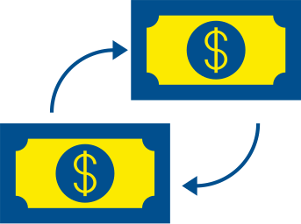







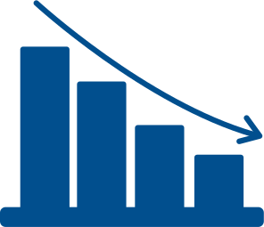



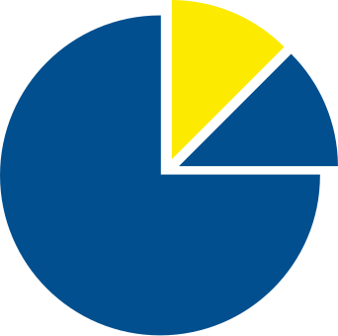




Free Resources
Use these free and recolourable icons and illustrations in your
Canva design.

